Slide 1
Making Tax Services Understandable
08 | The Problem
Users often don’t know what a tax step means or what to do next. The usual fix is to add a chatbot.

Slide 2
Why Chatbots Seem Like the Answer
Always available
Instant replies
Common questions
Help is there at any hour, without waiting for a helpline.
Users get an answer in seconds.
Frequent queries are answered without a human.
On paper, a chatbot fits the problem.

Slide 3
Where Chatbots Fall Short
Scripted chatbots
LLM chatbots
Both kinds
Limited by what the developer predicted users would ask. Unexpected wording gets a generic answer.
Users still need to know what to ask. Answers can be long, generic or wrong, and sit away from the confusing field.
One fixed explanation, even though users need different levels of detail.

Slide 4
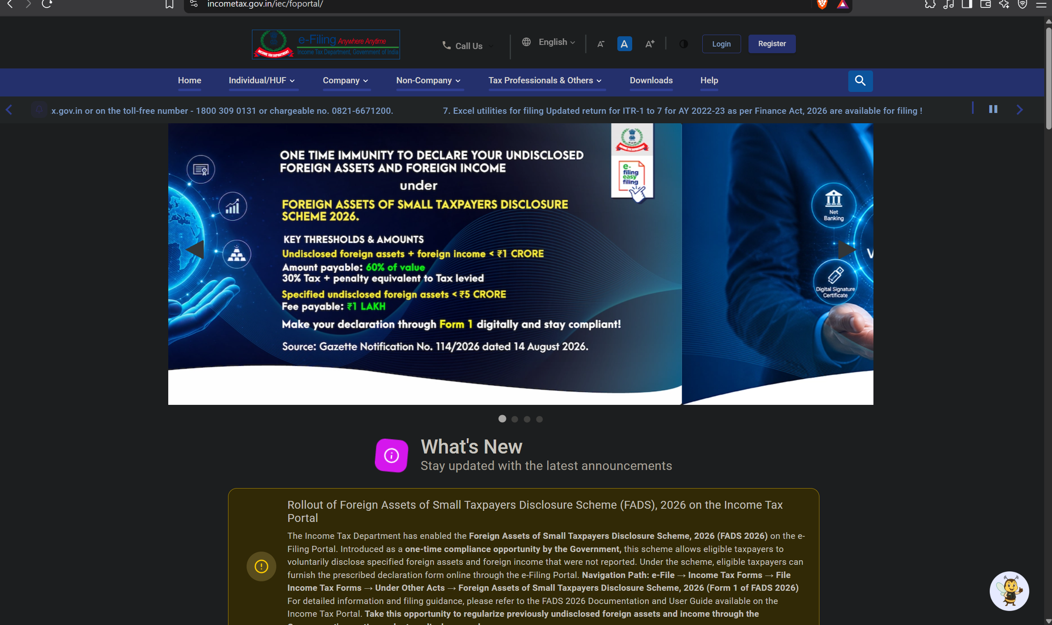
The confusion doesn’t start at the form. It starts at the front door.
Our Insight
The e-Filing home page shows a banner, a ticker, long announcements and seven menus before a new user finds where to start.
Source: incometax.gov.in/iec/foportal

Slide 5
The Understanding Layer
Guided start
“Regsterd User/ New User?” opens short paths into the right section.
Contextual help
A “?” at the exact field, with a short hint, a “learn more” option and an example.
Mismatch flags
Inline notes beside data that doesn’t line up, with a plain-language reason.
Progress cues
Users always see where they are in the process.

Slide 6
Why It Matters
Faster starts
Fewer errors
Quicker time to the first correct action, with fewer wrong turns.
Mismatches caught before submission, so fewer abandoned filings and less reliance on helplines and accountants.
Easy to adopt
Scalable
A layer on top of existing portals, so nothing has to be rebuilt.
“Explain at the point of confusion” works for any government or financial service.

Slide 7
Chatbots answer questions well, but the best help is the kind users never have to ask for. That’s what an understanding layer delivers.
Closing
We’re not adding tooltips. We’re changing who does the work of understanding: from the user to the interface.

